Slide 1
Optimale Hormontherapie
George Thalmann
Urologische Universitätsklinik
Bern

Slide 2
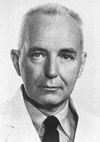
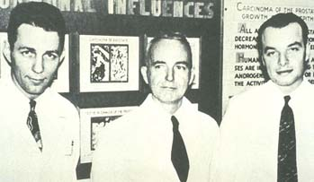
Charles B. Huggins

Slide 3
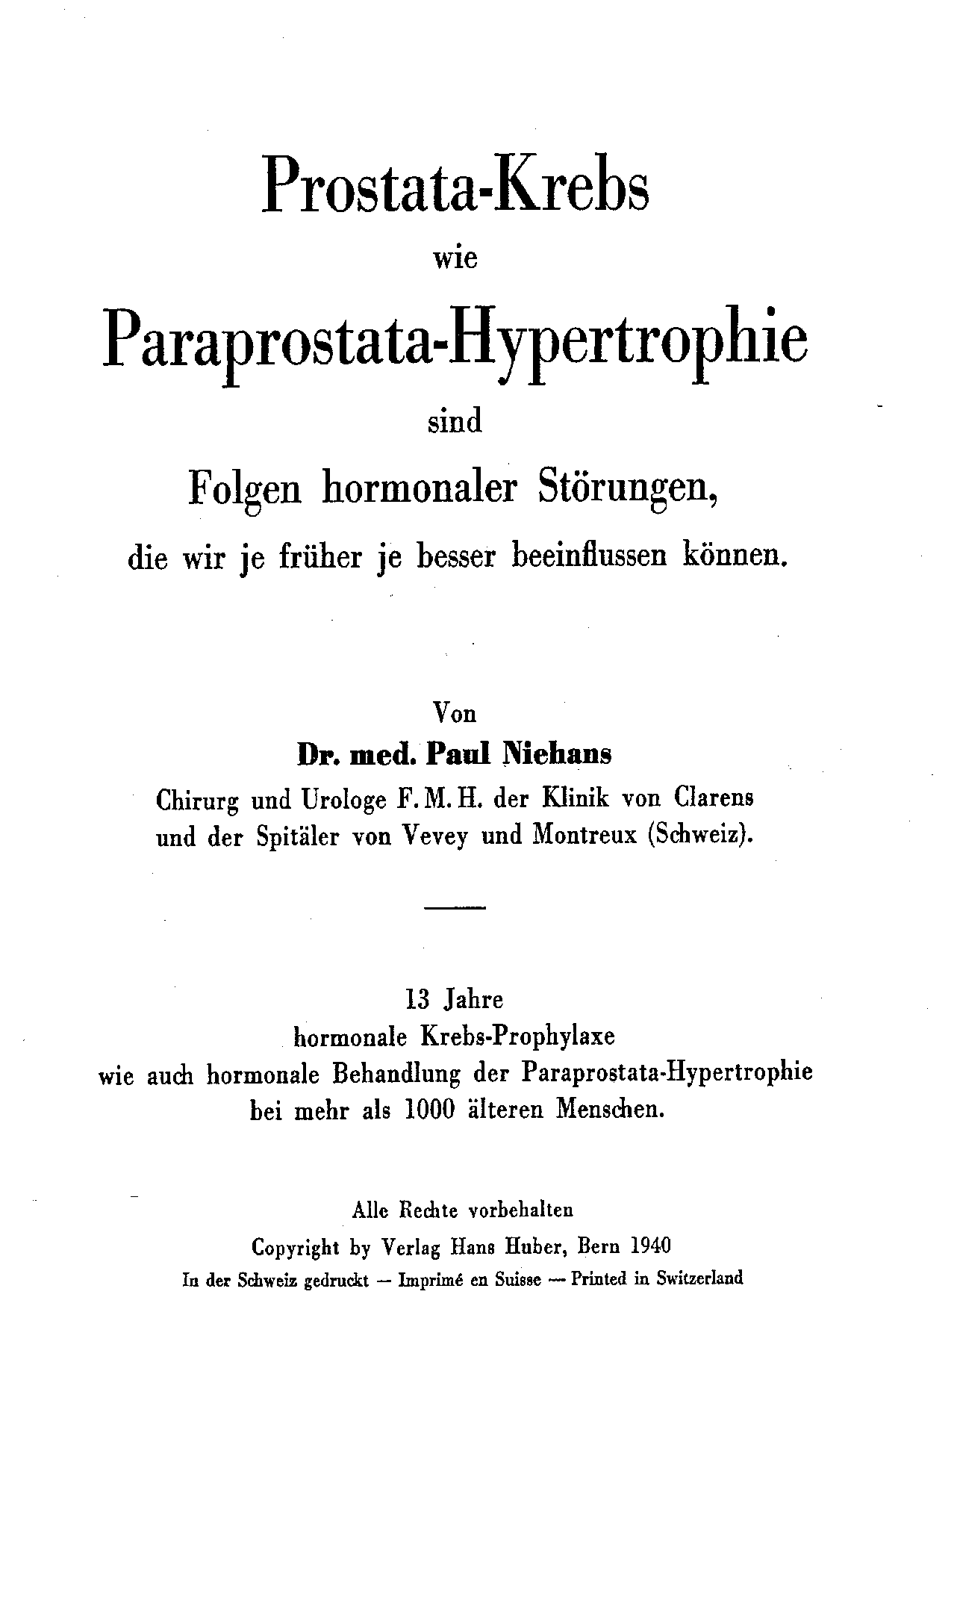

Slide 4
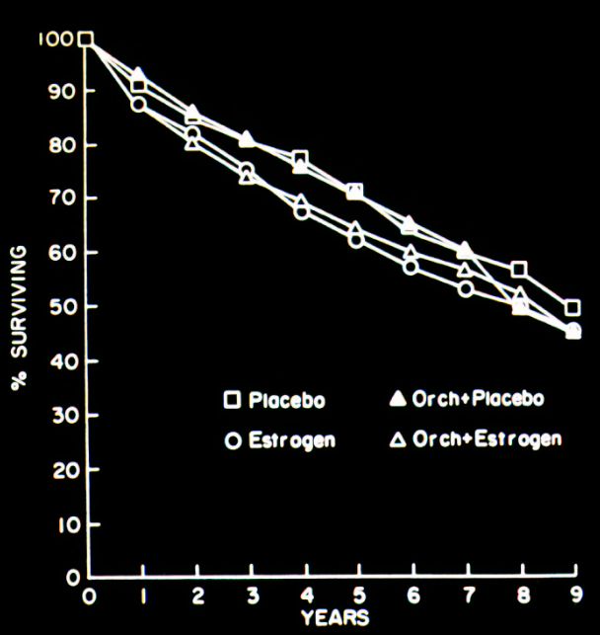

Slide 5
Estradurin versus combined
androgen deprivation
1.0
0.8
Treatment
combined androgen blockade
n = 455
parenteral estrogen n = 455
0.6
Probability of Survival
0.4
0.2
0.0
0
1
2
3
4
5
6
Years
Scandinavian Prostatic Cancer Group (SPCG) Study No. 5,
Scand J Urol Nephrol 36:405-413, 2002

Slide 6
0022-5347/02/1672-0535/0
The Journal of Urology Vol. 167, 535-538, February 2002
Copyright © 2002 by American Urological Association, Inc Printed in U.S.A.
DIETHYLSTILBESTEROL REVISITED: ADROGEN DEPRIVATION, OSTEOPOROSIS AND PROSTATE CANCER
DOUGLAS SCHERR, W. REID PITTS, JR. AND E. DARRACOTT VAUGHAN, JR.
From the Department of Urology, The New York Presbyterian Hospital-Cornell Medical Center, New York, New York
Results: There was a statistically significant (p < 0.05) higher level of urinary N-telopeptides/ creatinine in patients on androgen deprivation therapy who were not treated with diethylstil-besterol. The estrogenic effect of diethylstilbesterol protects one from bone resorption.
CONCLUSIONS
DES provides a safe, efficacious and time-tested treatment for prostate cancer. It not only provides clinically significant androgen deprivation, but it also likely has direct antitumor activity that is not otherwise present with conventional LHRH agonist therapy.
Notes:
Ablegen unter Stammdateien P‘Ca „DES + Bone“

Slide 7
PATCH
Prostate Adenocarcinoma: TransCutaneous Hormones
A randomised-controlled trial of transcutaneous oestrogen patches versus LHRH analogues in prostate cancer.
RANDOMISATION
Control Arm
Investigational Arm
LHRH analogues given as per local practice indefinitely
Transcutaneous Oestrogen Patches Induction Regimen – 3 patches changed twice weekly for 4 weeks
Maintenance regimen – 2 patches changed twice weekly indefinitely
Lancet Oncol 2013; 14: 306–16

Slide 8
Meta-Analyse Hormontherapie vs maximale Hormontherapie (n=27)
100
PROSTATE CANCER
8000 men in 27 trials of anti-androgen (nilutamide, flutamide or
cyproterone acetate)
80
60
alive
%
Androgen suppression
+ anti-androgen
40
Androgen
suppression
only
25.4%
20
23.6%
1.8% SD 1.3
6.2%
0.7% SD 1.1
(logrank
2p > 0.1; NS)
0
5.5%
0
5
10 years
Lancet 2000; 355: 1491-8
Notes:
Metaanalyse
MAB 1999

Slide 9
SWOG 8894 / Intergroup 105
Orchiectomy + Flutamide
Orchiectomy + Placebo
Orchiectomy
+ Flutamide
p - value
PSA normalized 69% 81% 0.01
Median time to progression 36 mo 49 mo 0.03
(good risk pts)
Overall survival 51 mo 52 mo N.S.
(good risk pts)
PSA is not an appropriate surrogate endpoint for survival

Slide 10
LNCaP und C4-2 Zellen und Bicalutamide
2
10 μmol
2
10 μmol
1.75
100 μmol
100 μmol
1000 μmol
1.75
1000 μmol
1.5
Control
1.5
Control
1.25
1.25
OD (570 nm)
OD (570 nm)
1
1
0.75
0.75
0.5
0.5
0.25
0.25
0
0
0
24
48
72h
0
24
48
72
PSA mRNA Expression
Ø Ø Ø
PSA mRNA Expression
Ø Ø Ø
PSA Protein Expression
Ø
PSA Protein Expression
Ø Ø
Peternac D, Thalmann GN et al. J Urol 2006, The Prostate 2008

Slide 11
Bicalutamide (150 mg) versus Placebo
for Prostate Cancer, SPCG - 6, EPC Trial
1.0
0.8
0.6
Proportion surviving
0.4
0.2
Bicalutamide 150 mg
Placebo
0.0
0
1
2
3
4
5
6
7
8
Time to death (years)
HR 1.47; 95% Cl 1.06, 2.03
Fig. 2. Kaplan-Meier curve shows overall survival in patients with localized disease receiving 150 mg bicalutamide in addition to standard care vs standard care alone.
P. Iversen et al., J. Urol., 172:1871-1876, 2004
Notes:
Prudenza! Influsso pubblicità marketing!
Stammdatei: P‘Ca
Datei: RX_+_-_Hormones

Slide 12
LHRH-Antagonisten ?
Schnelleres Erreichen von Kastrationswerten
Metaanalysen suggerieren ein besseres kardiovaskuläres Risikoprofil
Metaanalyse (n=5) besseres bPFS und OS
ABER:
«pooled data analysis»
Heterogene Populationen
Unterschiedliche Dosierungen
Grosse prospektive Studien notwendig
Schmerzhafte Injektionsstelle
T. Kimura et al., Urologic Oncology: Seminars and Original Investigations 33 (2015) 322–328

Slide 13
Sofortige vs. Verzögerte Therapie:
MRC Trial: locally advanced or metastatic P'Ca
100
Immediate n = 469
Deferred * n = 465
p < 0.2, immediate v. deferred
* 29 pts died from P'Ca before
treatment was started
75
Percent alive
50
25
0
0
469
465
1
430
430
2
358
349
3
280
260
4
207
207
5
152
136
6
103
85
7
73
52
8
40
27
9
23
15
10
11
5
At risk:
immediate
deferred
Years since randomisation
Time to death from any cause - all patients, by randomisation group
with courtesy from Prof. D. Kirk, Glasgow
Notes:
Prof. D. Kirk, Glasgow
V/2

Slide 14
Sofortige vs. Verzögerte Therapie:
MRC Trial: locally advanced or metastatic P'Ca
100
Immediate n = 256
Deferred n = 244
p < 0.0001, immediate v. deferred
75
Percent without relevant event
50
25
0
0
256
244
1
237
201
2
206
156
3
165
118
4
125
92
5
86
64
6
59
38
7
38
22
8
20
13
9
12
9
10
7
2
At risk:
immediate
deferred
Years since randomisation
Time to distant disease progression, or death from prostate cancer - patients
entered as non metastatic (M0), by randomisation group.
with courtesy from Prof. D. Kirk, Glasgow
Notes:
Prof. D. Kirk, Glasgow
V/1

Slide 15
Immediate vs deferred Treatment for asymptomatic P Ca patients To-4, No-2, Mo Not suitable for local treatment with curative intent (EORTC trial 30891)
1002 patients, median age 74 years
T2 disease 35%, T3-4 disease 45%
N pos 5%
Cardiovascular comorbidity 35%
PSA median 12.7 (0.1 – 1306)
After a median follow-up 6.4 years: 50% died

Slide 16
Trial design and objectives
Patients
with newly diagnosed untreated asymptomatic
T0-4 N0-2 M0
(UICC 1982)
PCa
not suitable for local treatment with curative intent
Immediate orchiectomy
or depot LH-RH
N=492
R
Deferred* orchiectomy
or depot LH-RH
N=493
*Treatment starts upon events of symptoms from metastases, ureteric obstruction or decrease > of WHO performance status. Not for only rise in PSA, new hot spots or asymptomatic mets
Updated results with 12.9 years of median follow-up

Slide 17
Overall survival
100
90
80
70
60
50
40
37.4%(CI: 32.9-41.9%)
30
20
10
26.2% (CI: 22.2-30.4%)
0
(years)
0
2
4
6
8
10
12
14
16
18
20
O
N
Number of patients at risk :
Treatment
373
492
428
362
289
226
159
79
35
6
1
Immediate
396
493
433
336
250
187
115
48
25
6
0
Deferred

Slide 18
Wer profitiert von sofortiger Hormontherapie?
PSA > 50 ng/ml
PSADT < 12 Monate

Slide 19
Prostatakarzinom Mortalität
100
90
Deferred/immediate
HR=1.17 (95%CI: 0.92-1.49)
P=0.19
80
70
60
50
40
22.2% (CI: 18.4-25.9%)
30
20
21.0% (CI: 17.3-24.7%)
10
0
(years)
0
2
4
6
8
10
12
14
16
18
20
O
N
Number of patients at risk :
Treatment
133
492
428
362
289
226
159
79
35
6
1
Immediate (P Ca)
136
493
433
336
250
187
115
48
25
6
0
Deferred (P Ca)

Slide 20
Andere Ursachen Mortalität
100
90
HR= 1.23 (CI: 1.03, 1.47)
P (difference)=0.021
80
70
42.5% (CI: 38.1-47.0%)
60
50
40
37.8% (CI: 33.4-42.1%)
30
20
10
0
(years)
0
2
4
6
8
10
12
14
16
18
20
O
N
Number of patients at risk :
Treatment
240
492
428
362
289
226
159
79
35
6
1
Immediate
260
493
433
336
250
187
115
48
25
6
0
Deferred

Slide 21
Zeit bis zur objektiven Progression bei sofortiger oder verzögerter Hormontherapie
100
90
80
70
Deferred ADT – first objective progression = Hormone SENSITIVE
HR to immediate= 1.76 (CI: 1.43-2.17) P<0.0001
60
50
40
Immediate ADT – first objective
= ADT refractory prog
30
Time on ADT
20
Deferred ADT – ADT refractory objective progression
HR to immediate= 1.01 (CI: 0.80-1.27) P=0.93
10
0
(years)
0
2
4
6
8
10
12
14
16
18
20
O
N
Number of patients at risk :
152
492
420
340
272
208
142
74
33
6
1
Immediate
210
493
369
264
193
137
80
38
21
6
0
Def. – 1st PD
139
493
423
318
236
174
103
45
24
6
0
Def. ADT refract.

Slide 22
Beginn verzögerte Hormontherapie
100
90
Died without ever needing ADT 31%
80
70
No need yet 4%
60
Refusal 5% or lost/ineligible (6%)
50
40
At 10 years, only 54% had started treatment
30
20
10
0
(years)
0
2
4
6
8
10
12
14
16
18
O
N
Number of patients at risk :
275
493
326
199
129
76
38
14
7
1
Deferred ADT

Slide 23
Immediate vs deferred Treatment for asymptomatic P Ca patients To-4, No-2, Mo Not suitable for local treatment with curative intent (EORTC trial 30891)
1002 patients, median age 74 years
T2 disease 35%, T3-4 disease 45%
N pos 5%
Cardiovascular comorbidity 35%
PSA median 12.7 (0.1 – 1306)
After a median follow-up 6.4 years: 50% died
Approximately 2/3 of pts did not die from P Ca

Slide 24
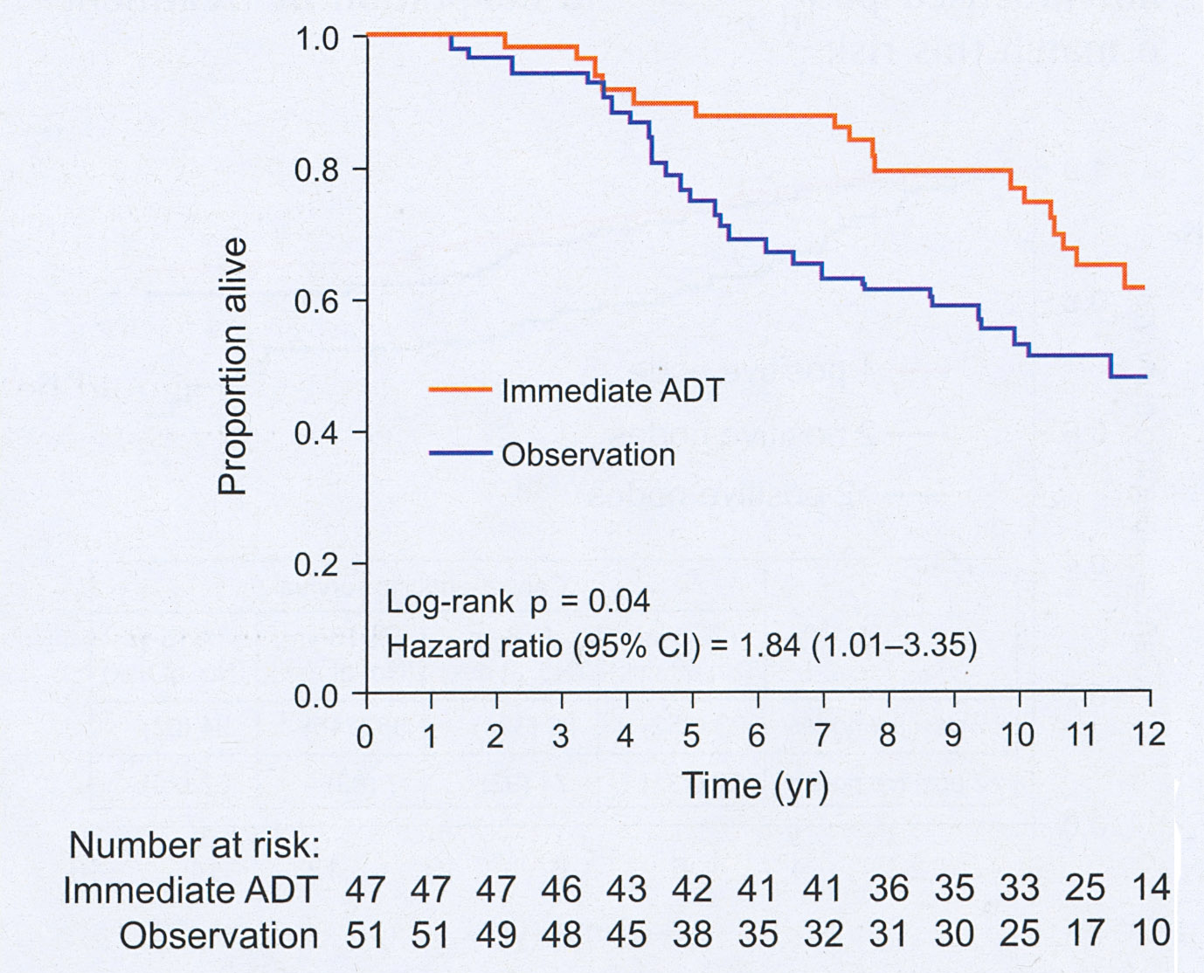
Allgemeines Überleben nach radikaler Prostatektomie und sofortiger oder verzögerter Hormontherapie
E.M. Messing et al., Lancet Oncol, 7:472-479, 2006

Slide 26
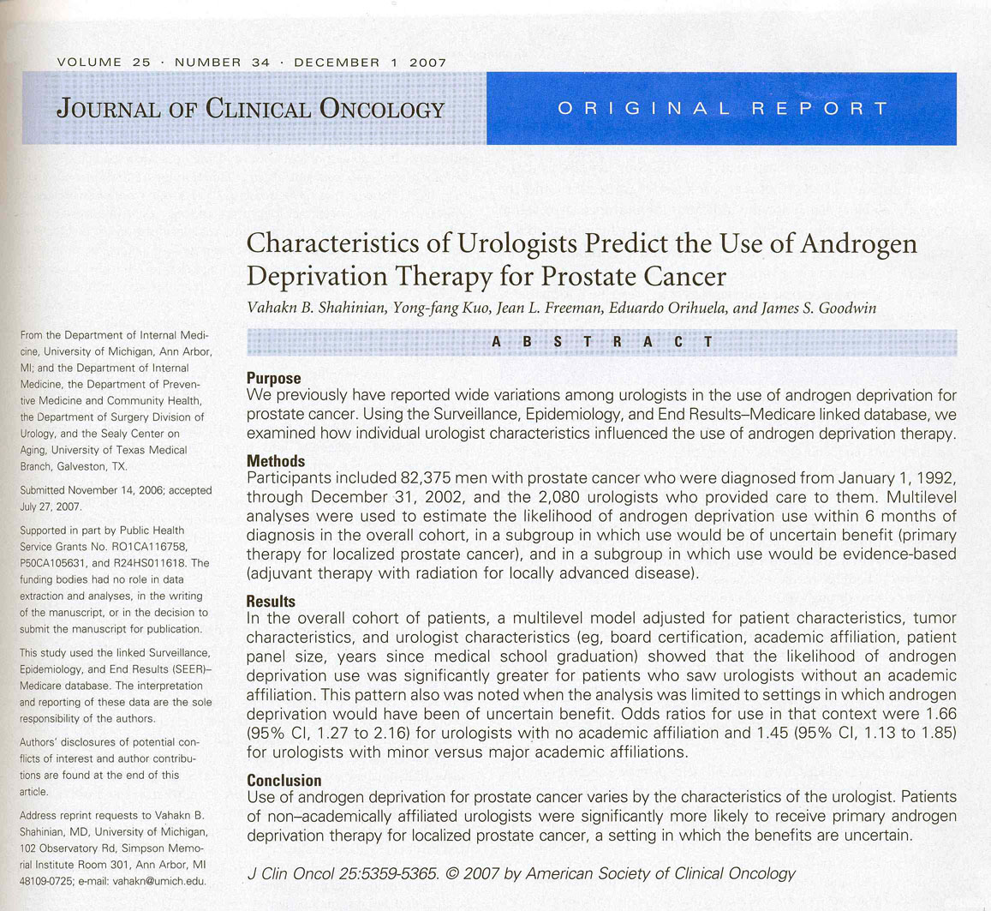

Slide 27
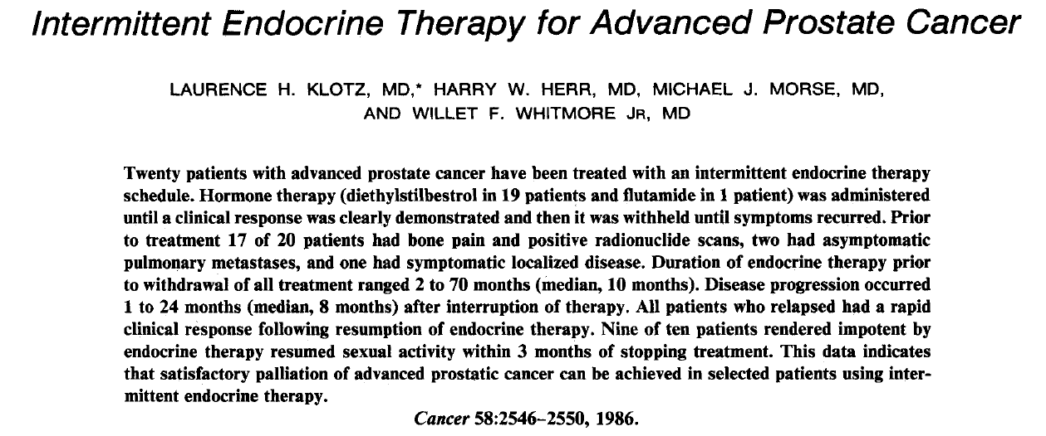

Slide 28
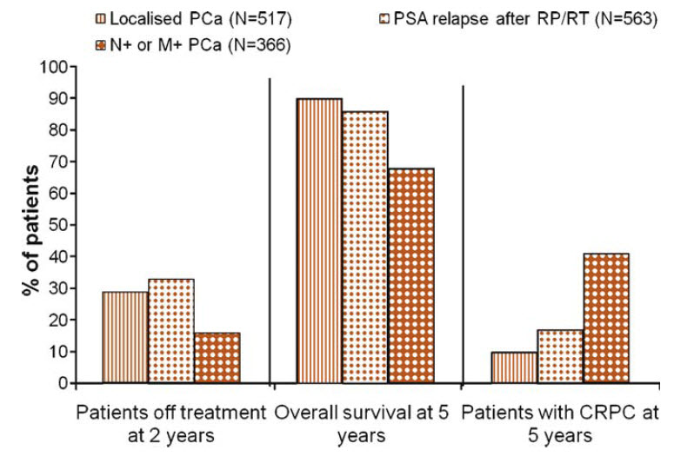
Meta-Analyse 10 Phase 2 Studien
intermittierende Hormontherapie
C.C. Schulman, Eur Urol Suppl 8:852-856, 2009

Slide 29
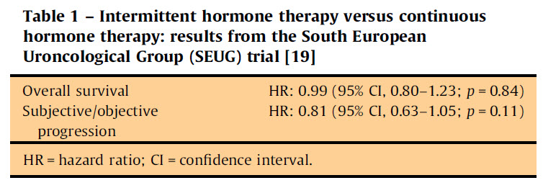
Meta-Analyse 10 Phase 2 Studien
intermittierende Hormontherapie
C.C. Schulman, Eur Urol Suppl 8:852-856, 2009

Slide 30
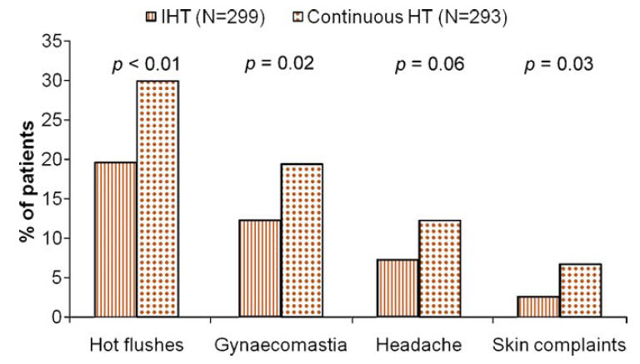
Nebenwirkungsprofil
C.C. Schulman, Eur Urol Suppl 8:852-856, 2009

Slide 31
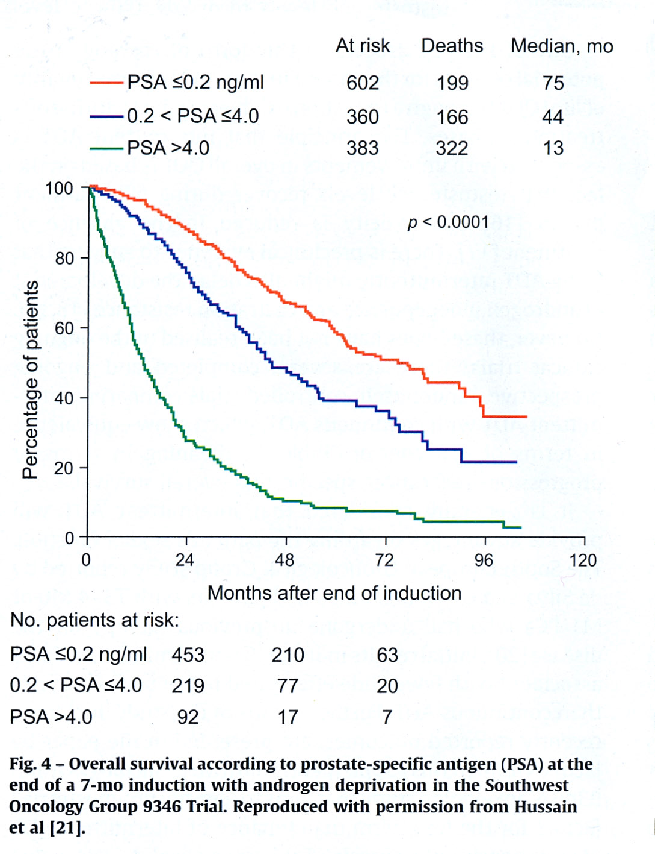
M. Hussain et., J Clin Oncol, 24:3984-3990, 2006

Slide 32
Hormontherapie plus Strahlentherapie
Krebsspezifisches Überleben
Allgemeines Überleben
A. Widmark, O. Klepp, A. Solberg et al., Lancet, 373:301-308, 2009

Slide 33
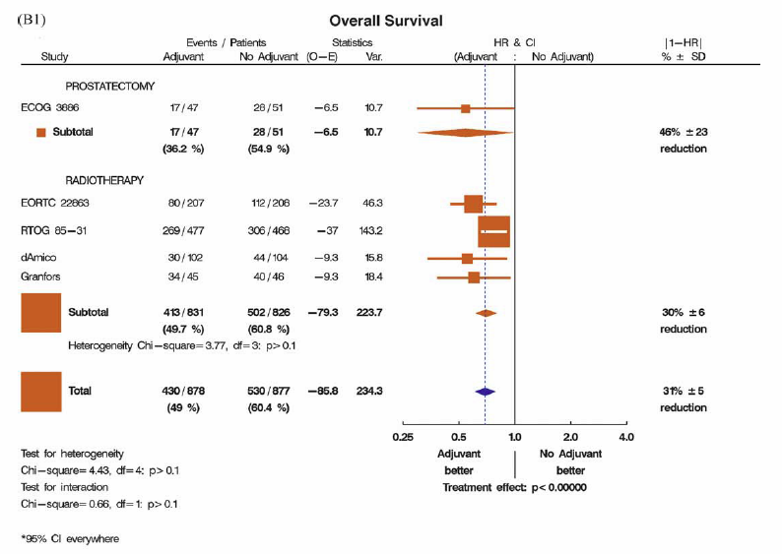
Behandlung des Primärtumors
Verhagen PC et al., Eur Urol 2010 Aug;58(2):261-9

Slide 34
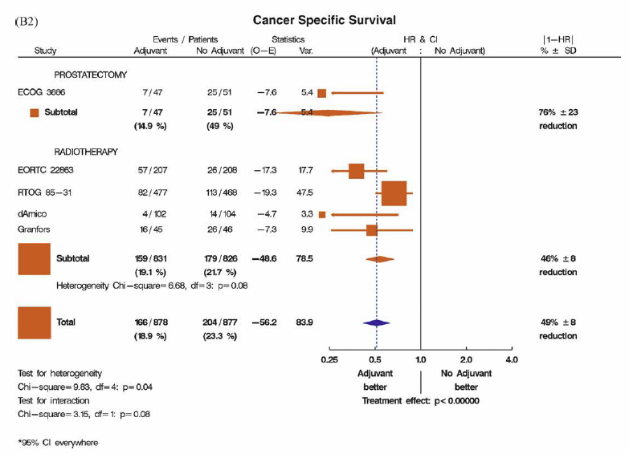
Behandlung des Primärtumors
Verhagen PC et al., Eur Urol 2010 Aug;58(2):261-9

Slide 35
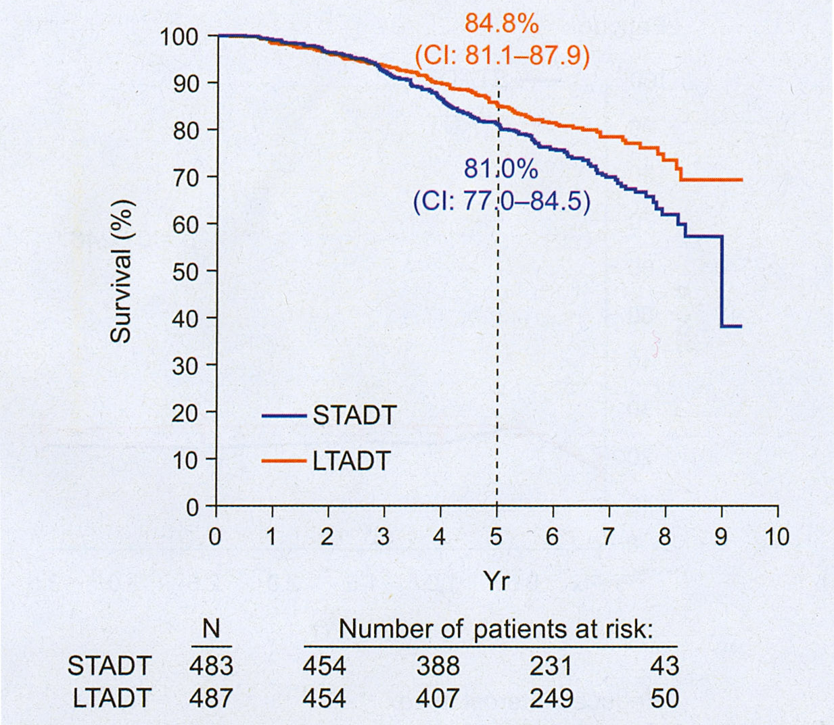
Allgemeines Überleben nach Strahlentherapie bei fortgeschrittenem PCA kurz vs langer Hormontherapie
M. Bolla, T.M. de Reijke, G. Van Tienhoven et al., N Engl J Med, 360:2516-2527, 2009

Slide 36
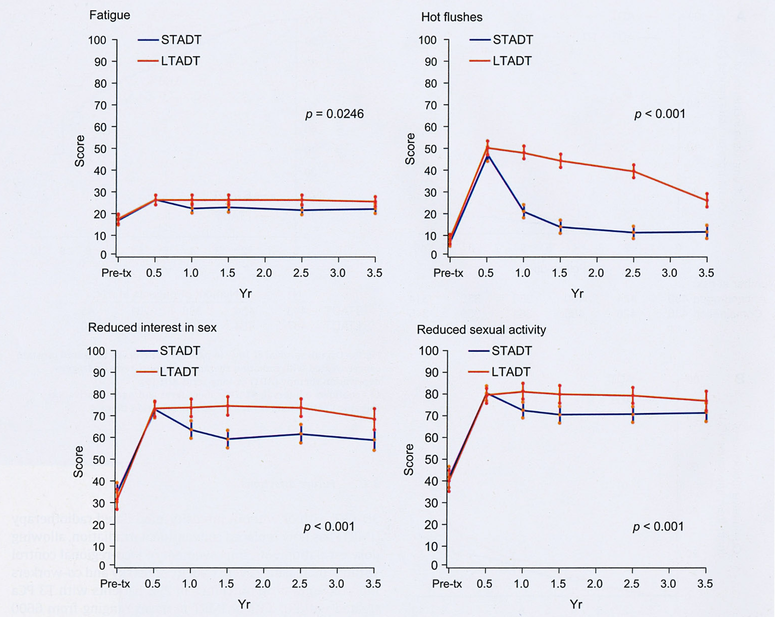
Nebenwirkungen bei Strahlentherapie bei fortgeschrittenem PCA kurzer vs langer Hormontherapie
M. Bolla, T.M. de Reijke, G. Van Tienhoven et al., N Engl J Med, 360:2516-2527, 2009

Slide 37
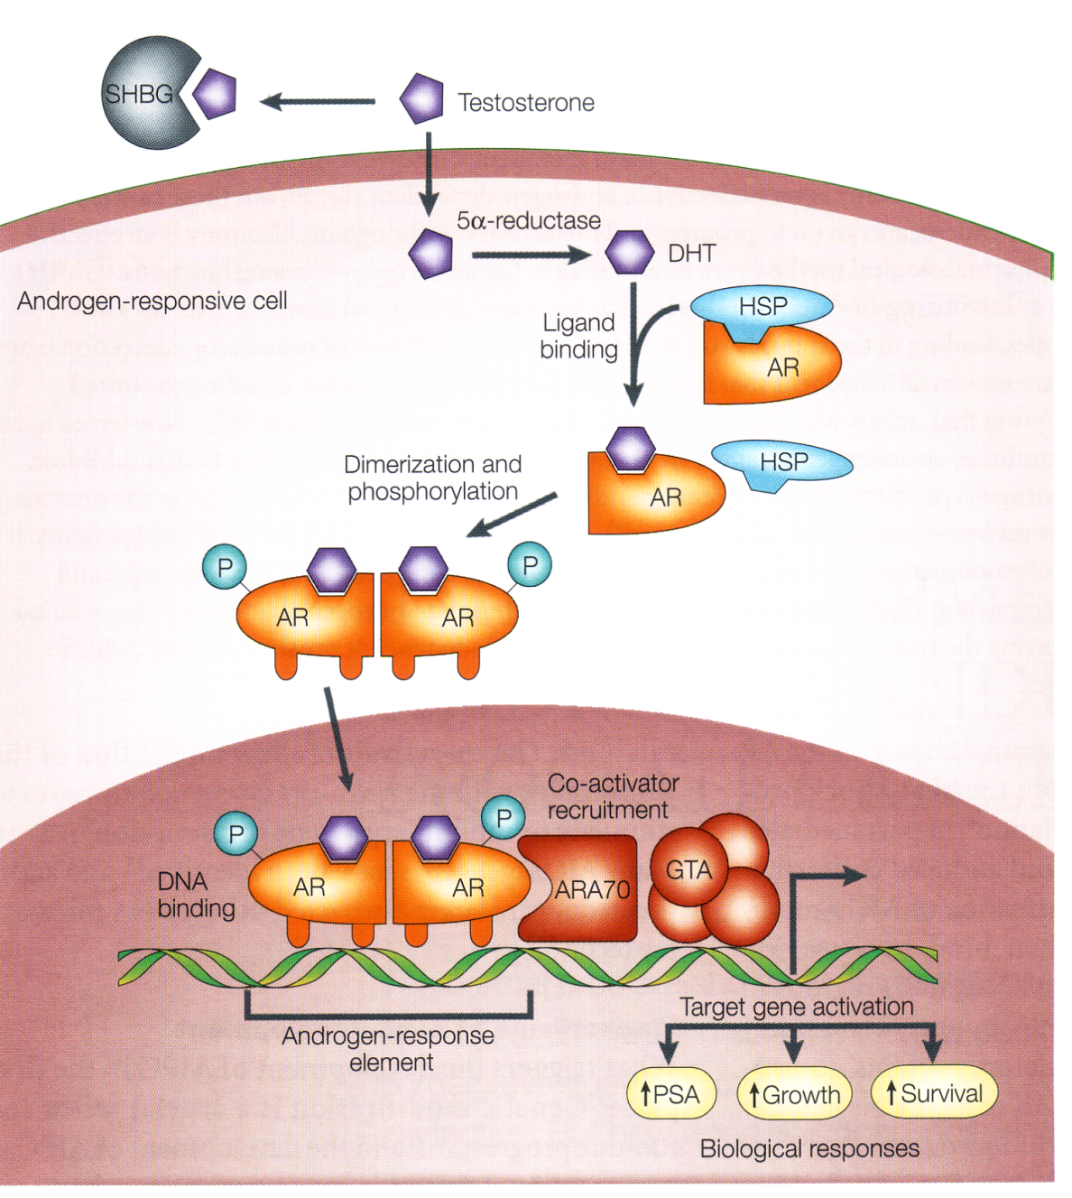
Androgen receptor activation
Feldmann et al., Nature Reviews Cancer, 2001

Slide 38
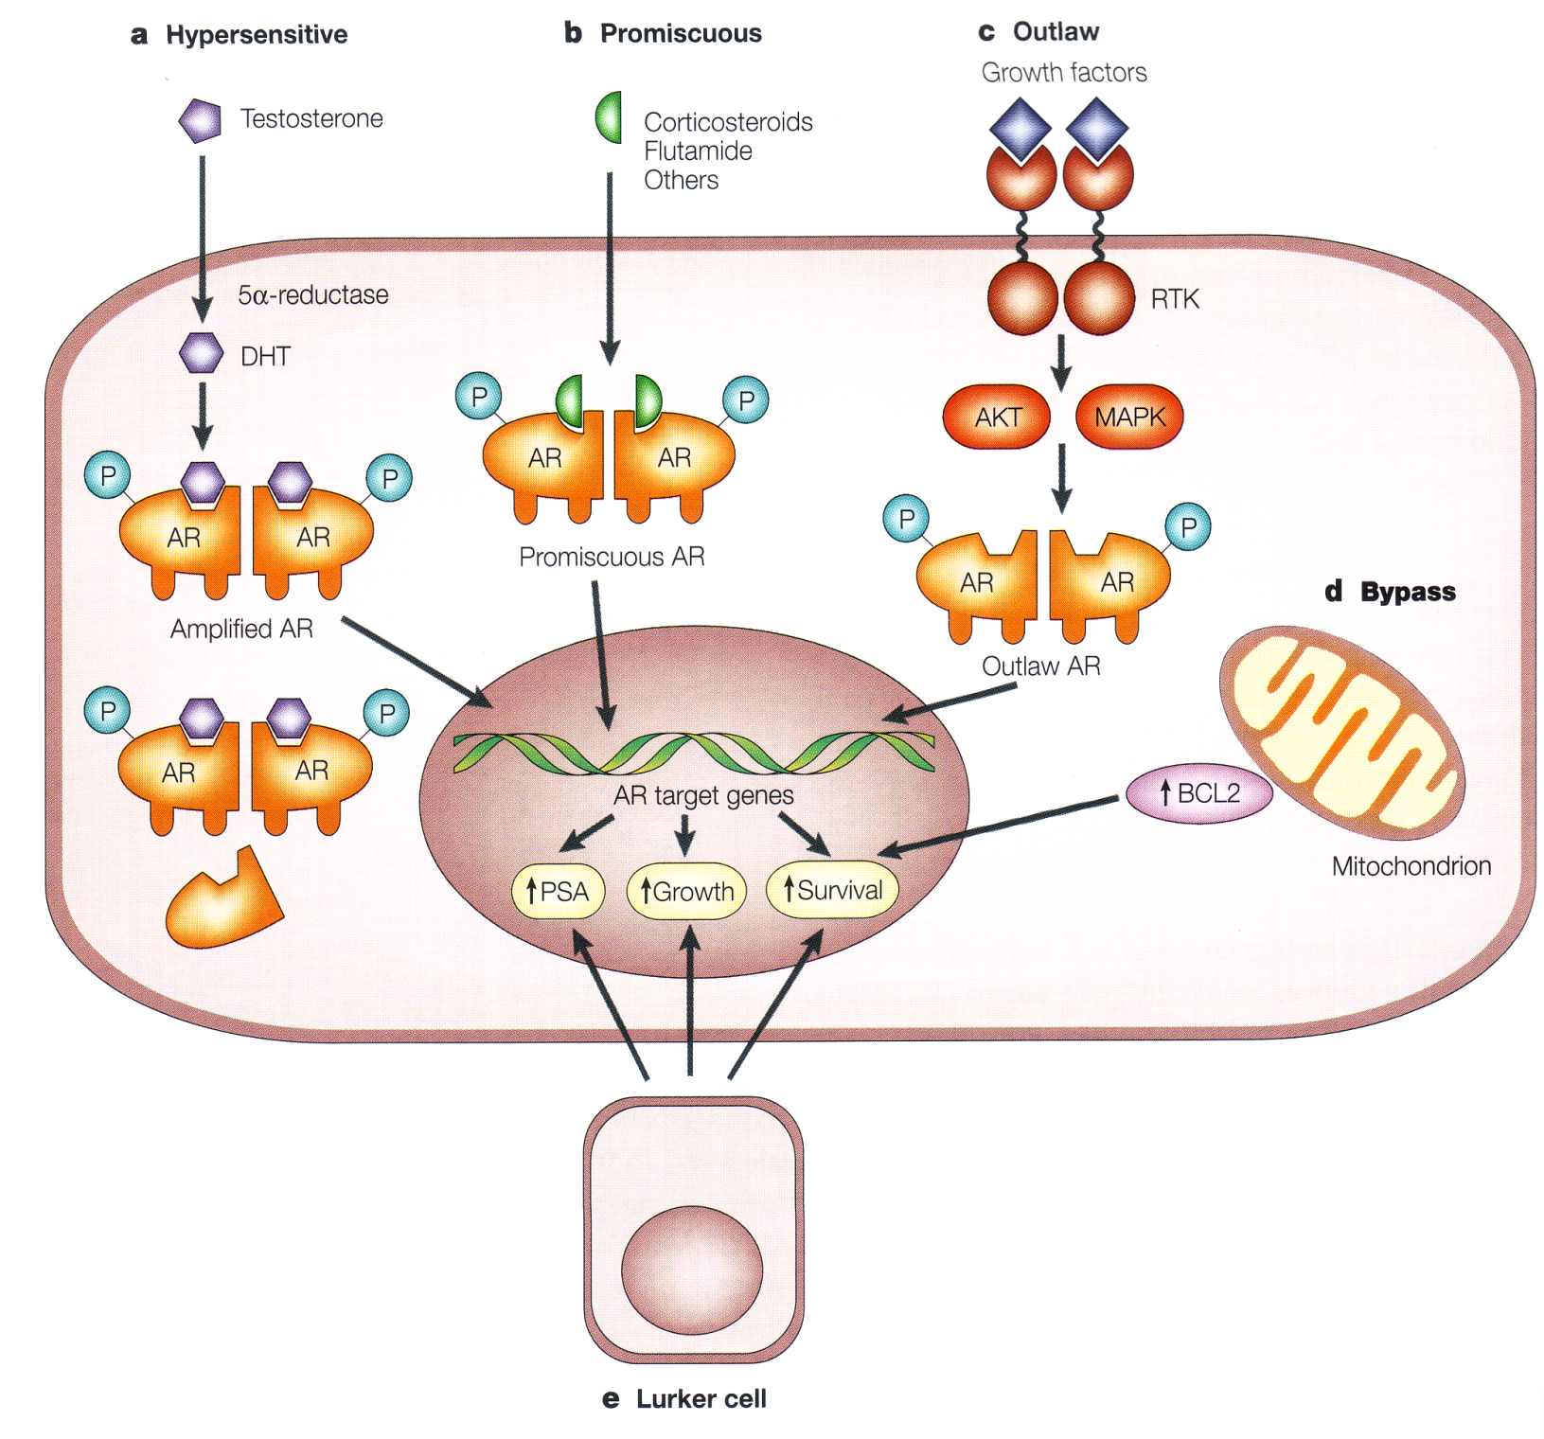
Androgen synthesis
cytochrome P-450c17
X
Feldmann et al., Nature Reviews Cancer, 2001

Slide 39
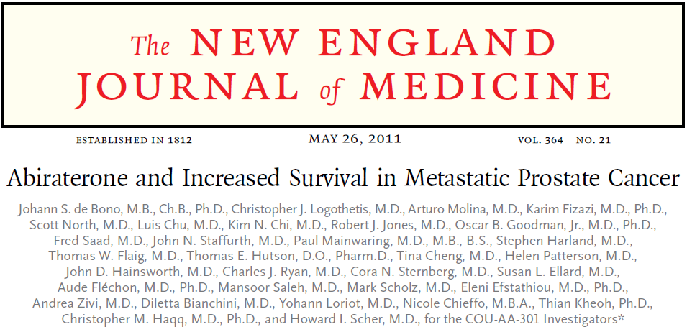
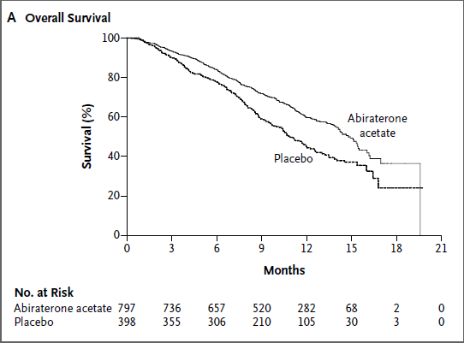
Abiraterone Acetate Overall Survival

Slide 40
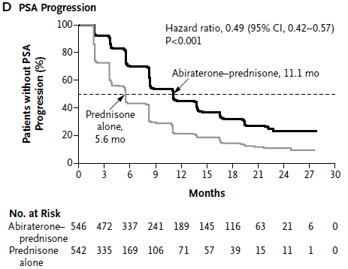
Abiraterone Acetate PSA Progression

Slide 41
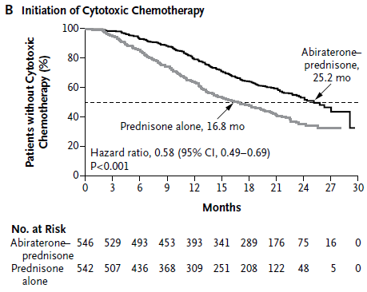
Abiraterone Acetate Chemotherapie-freies Überleben

Slide 42
...and a new story beginning?

Slide 43
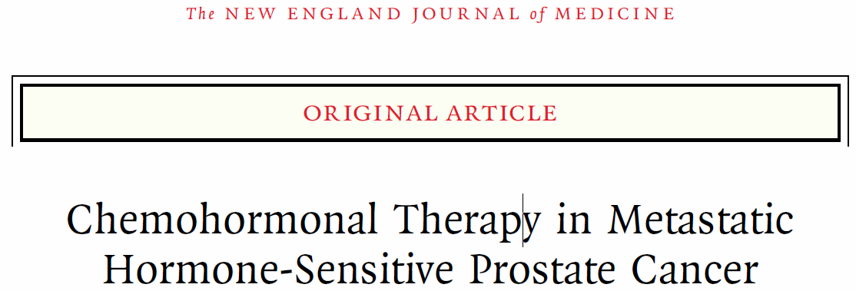
Sweeney et al., N Engl J Med 2015;373:737-46.

Slide 44
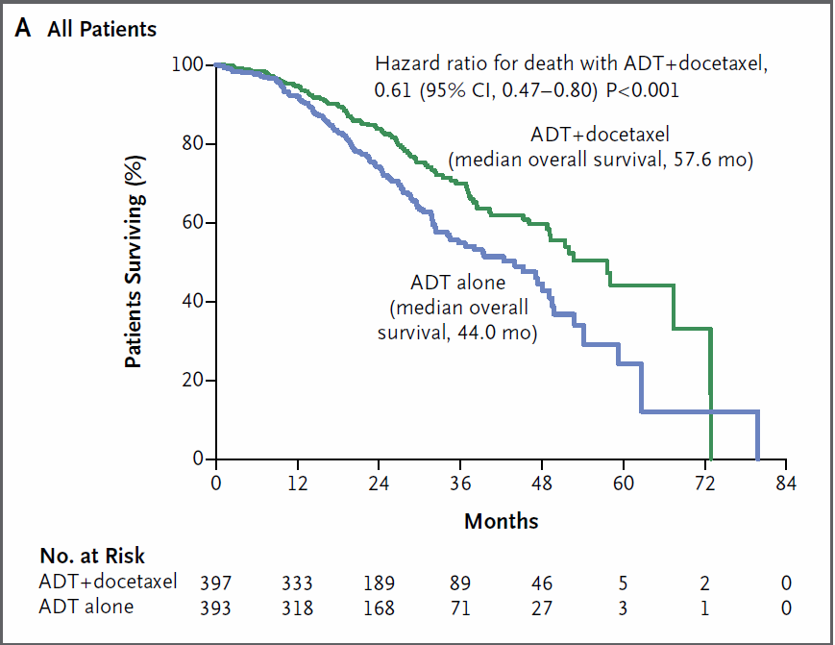

Slide 45
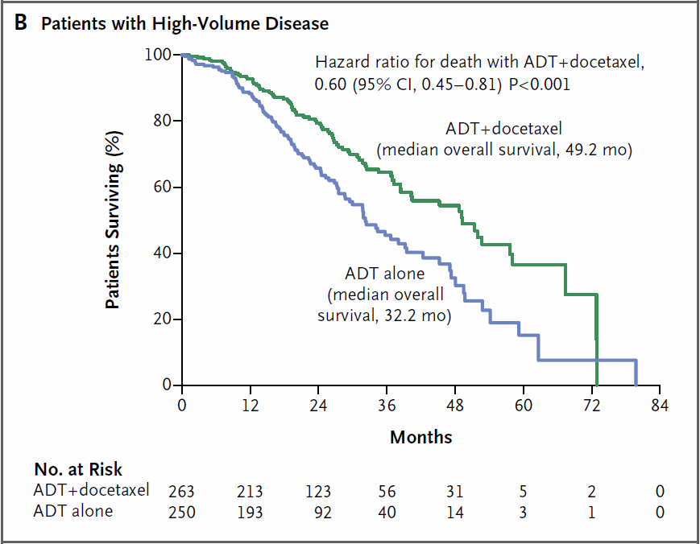

Slide 46
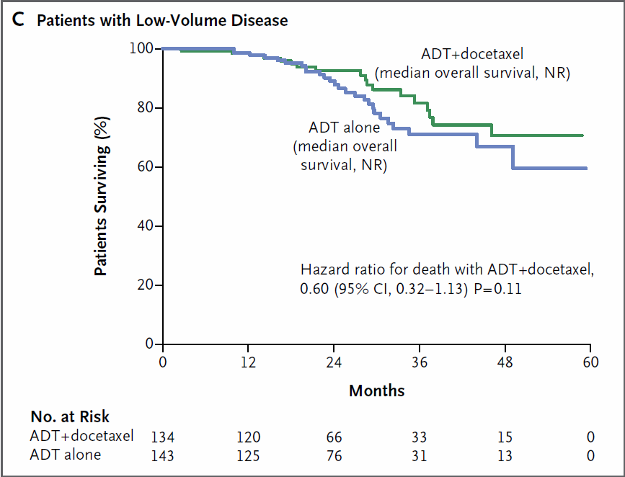

Slide 47
Overall Survival
Tucci M et al. Eur Urol in press

Slide 48
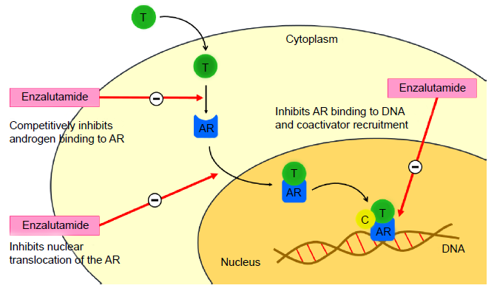
Enzalutamide
Rodriguez-Vida A et al., Drug Design, Development and Therapy 2015

Slide 49
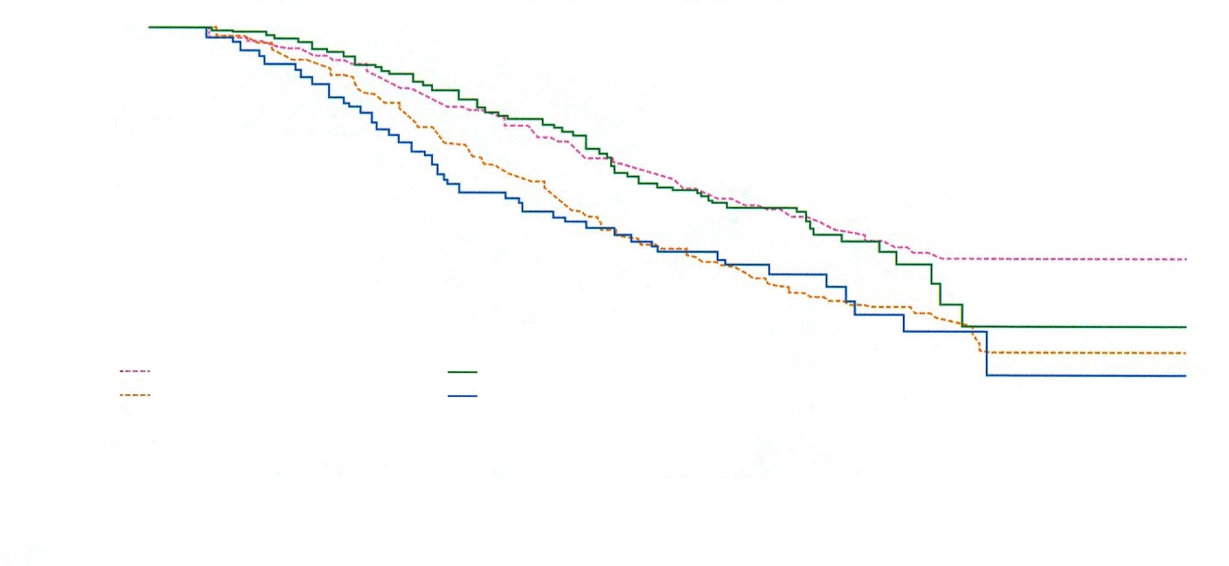
AFFIRM Study
100%
80%
Overall survival (%)
60%
40%
Patients <75 years
Enzalutamide: not yet reached
Patients ≥75 years
Enzalutamide: 18.2 months
20%
Placebo: 13.6 months
ᶺHR =0.63 (95%Cl 0.52-0.78)
p>0.001
Placebo: 13.3 months
ᶺHR =0.61 (95%Cl 0.43-0.86)
p>0.004
0%
0
3
6
9
12
15
18
21
24
ITT= Intention-to-treat,ᶺHR=Hazard Ratio
Months
-
Scher HI et al., N Engl J Med. 2012 Sep 27;367(13):1187-97.

Slide 50
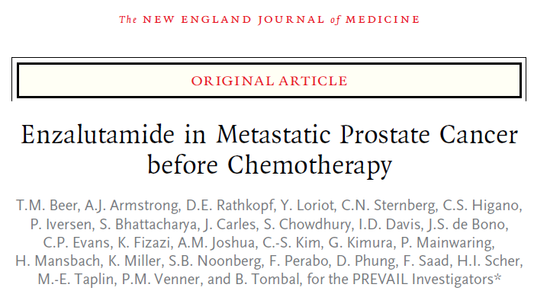
Conclusions
Enzalutamide significantly decreased the risk of radiographic progression and death and delayed the initiation of chemotherapy in men with metastatic prostate cancer.
N Engl J Med 2014;371:424-33.

Slide 51
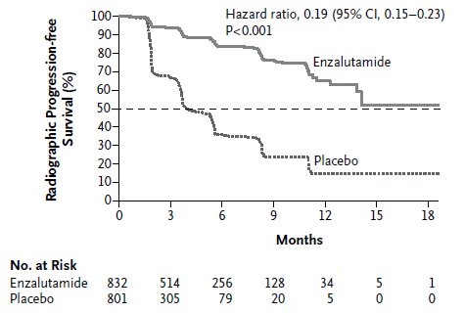
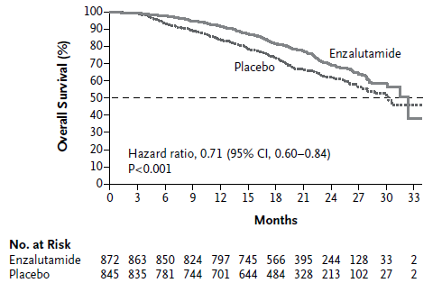
PREVAIL Studie

Slide 52
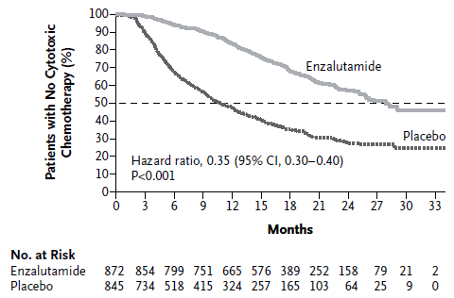
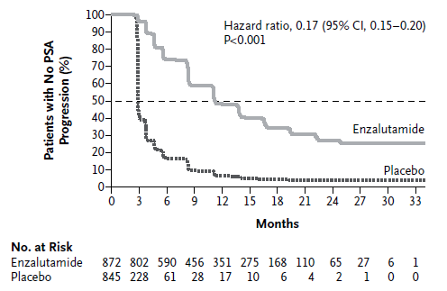
PREVAIL Studie

Slide 53
Schlussfolgerungen
Moderate aber statistisch signifikante Verbesserung des allgemeinen Überlebens mit sofortiger Hormontherapie
Keine signifikante Differenz bzgl. PCA Mortalität und symptomfreies Überleben.
Oestrogene könnten wieder attraktiv werden
Primäre Hormontherapie kombiniert mit Strahlentherapie
Kombinierte Hormonochemotherapie auf dem Vormarsch
Gute Zweitlinienhormontherapien

Slide 54
Danke für Ihre Aufmerksamkeit

Slide 56
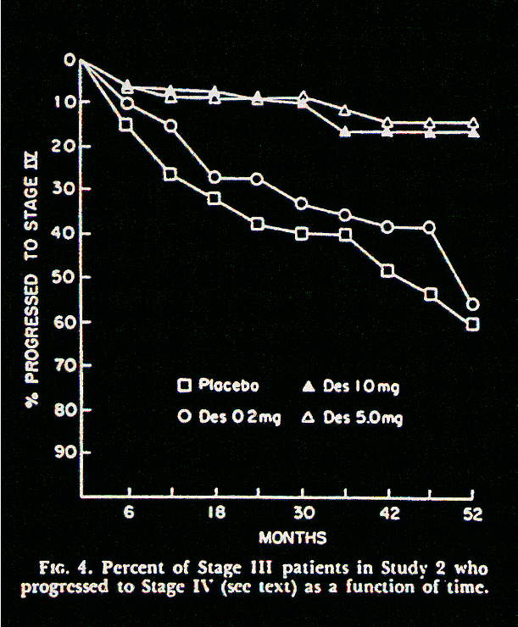

Slide 57
Androgen Deprivation Side effects
Testosterone Loss and Estradiol
Administration Modify Memory in Men
Tomasz M. Beer, Lisa B. Bland, Joseph R. Bussiere, Michelle B. Neiss,
Emily M. Wersinger,Mark Garzotto, Christopher W. Ryan and Jeri S. Janowsky
From the Department of Medicine,, Division of Hematology and Medical Oncology (TMB, EMW, CWR),
and Department of Behavioral Neuroscience (JRB, MBN, JSJ), Oregon Health and Science University,
and Division of Urology, Oregon Health and Science University and Portland Veterans Affairs Medical Center
(LBB, MG), Portland, Oregon
Conclusions: Sex steroid loss and replacement have effects on specific cognitive processes in older men. Furthermore, estrogen has the potential to reverse the neurotoxic effects on memory Performance caused by androgen deprivation.
J. Urol., 175:130-135, 2006

Slide 58
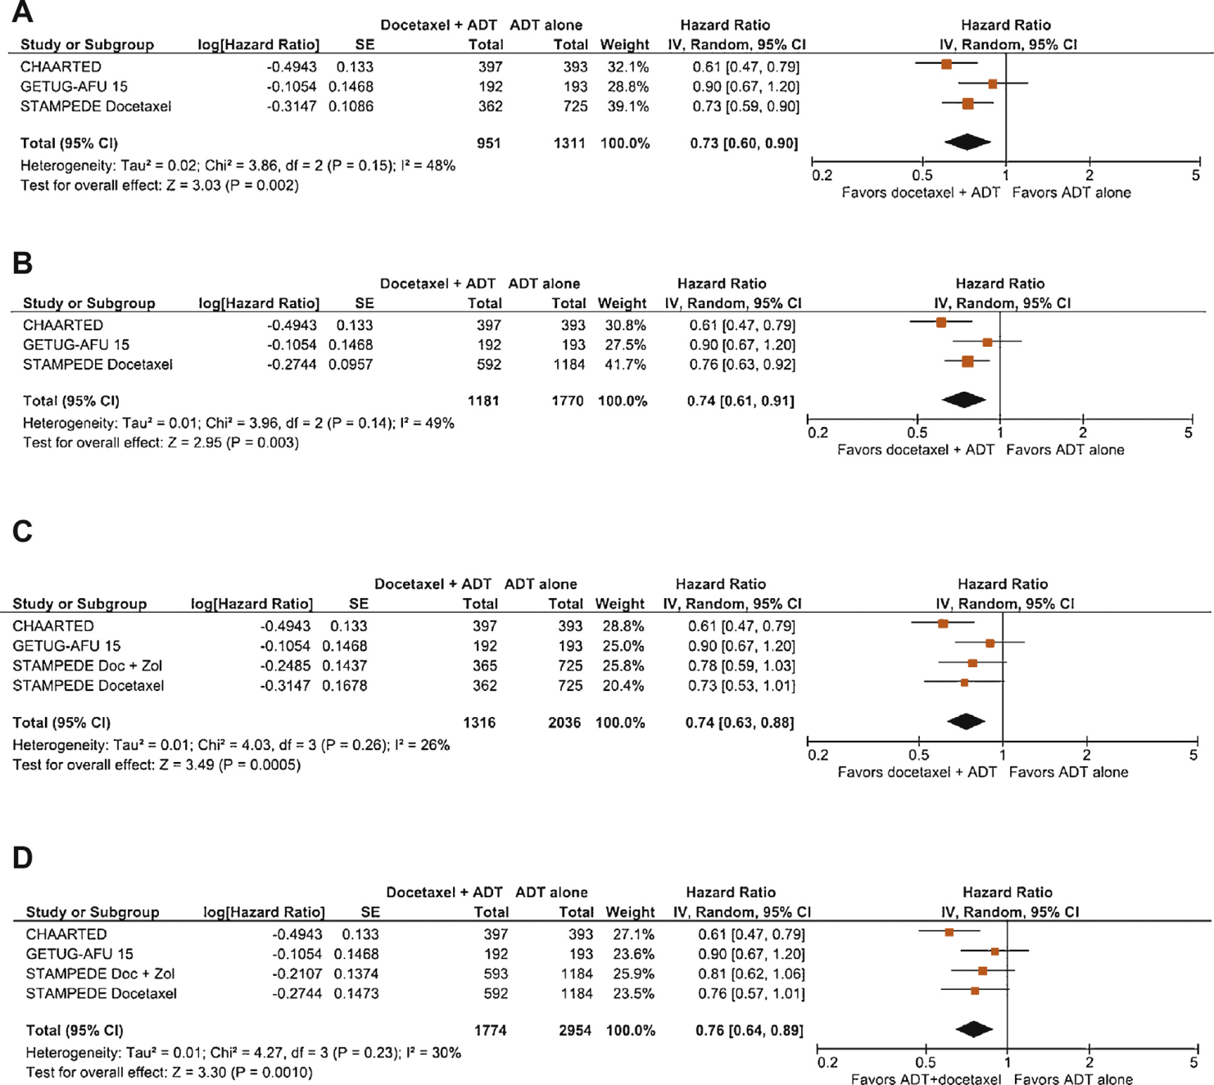
Overall Survival
M+
Alle
M+
Alle
Tucci M et al. Eur Urol in presss

